Slide 1
Optimizing Pager Rotation Duties in DevOps: Industry Best Practices and Insights
Enhancing on-call efficiency with proven strategies
Amanda Wedergren
November 24, 2025

Slide 2

Introduction to Pager Rotation in DevOps
Structured On-Call Scheduling
Pager rotation organizes team members to take scheduled turns being on-call for incident response.
Timely Incident Resolution
Rotation ensures incidents are addressed promptly by the designated on-call engineer at any time.
Even Responsibility Distribution
Pager rotation balances workload and responsibility fairly across all DevOps team members.

Slide 3

Key Principles and Objectives of Pager Rotation
Core Principles
Fairness, predictability, and responsiveness ensure effective and equitable pager rotation among team members.
Minimizing Personal Impact
Reducing pager rotation's effect on personal time fosters team well-being and improved morale.
System Reliability and Accountability
Pager rotation supports maintaining system reliability while promoting accountability within the team.

Slide 4

Setting Up Effective On-Call Schedules
Balanced Workload
Effective on-call schedules balance rotation length and ensure holiday coverage to prevent burnout.
Backup Support
Including backup support in schedules maintains service continuity during absences or emergencies.
Clear Documentation
Clear documentation and communication avoid confusion and ensure smooth handoffs between shifts.

Slide 5

Minimizing Burnout and Improving Team Well-Being
Limit On-Call Shifts
Reducing the number of on-call shifts helps prevent exhaustion and maintains team energy levels.
Provide Adequate Rest
Ensuring sufficient rest periods between shifts allows teams to recover and stay productive.
Encourage Time Off Post-Incidents
Promoting time off after stressful incidents helps team members recover emotionally and physically.
Foster Supportive Culture
Building a supportive culture acknowledges on-call challenges and encourages team well-being.

Slide 6
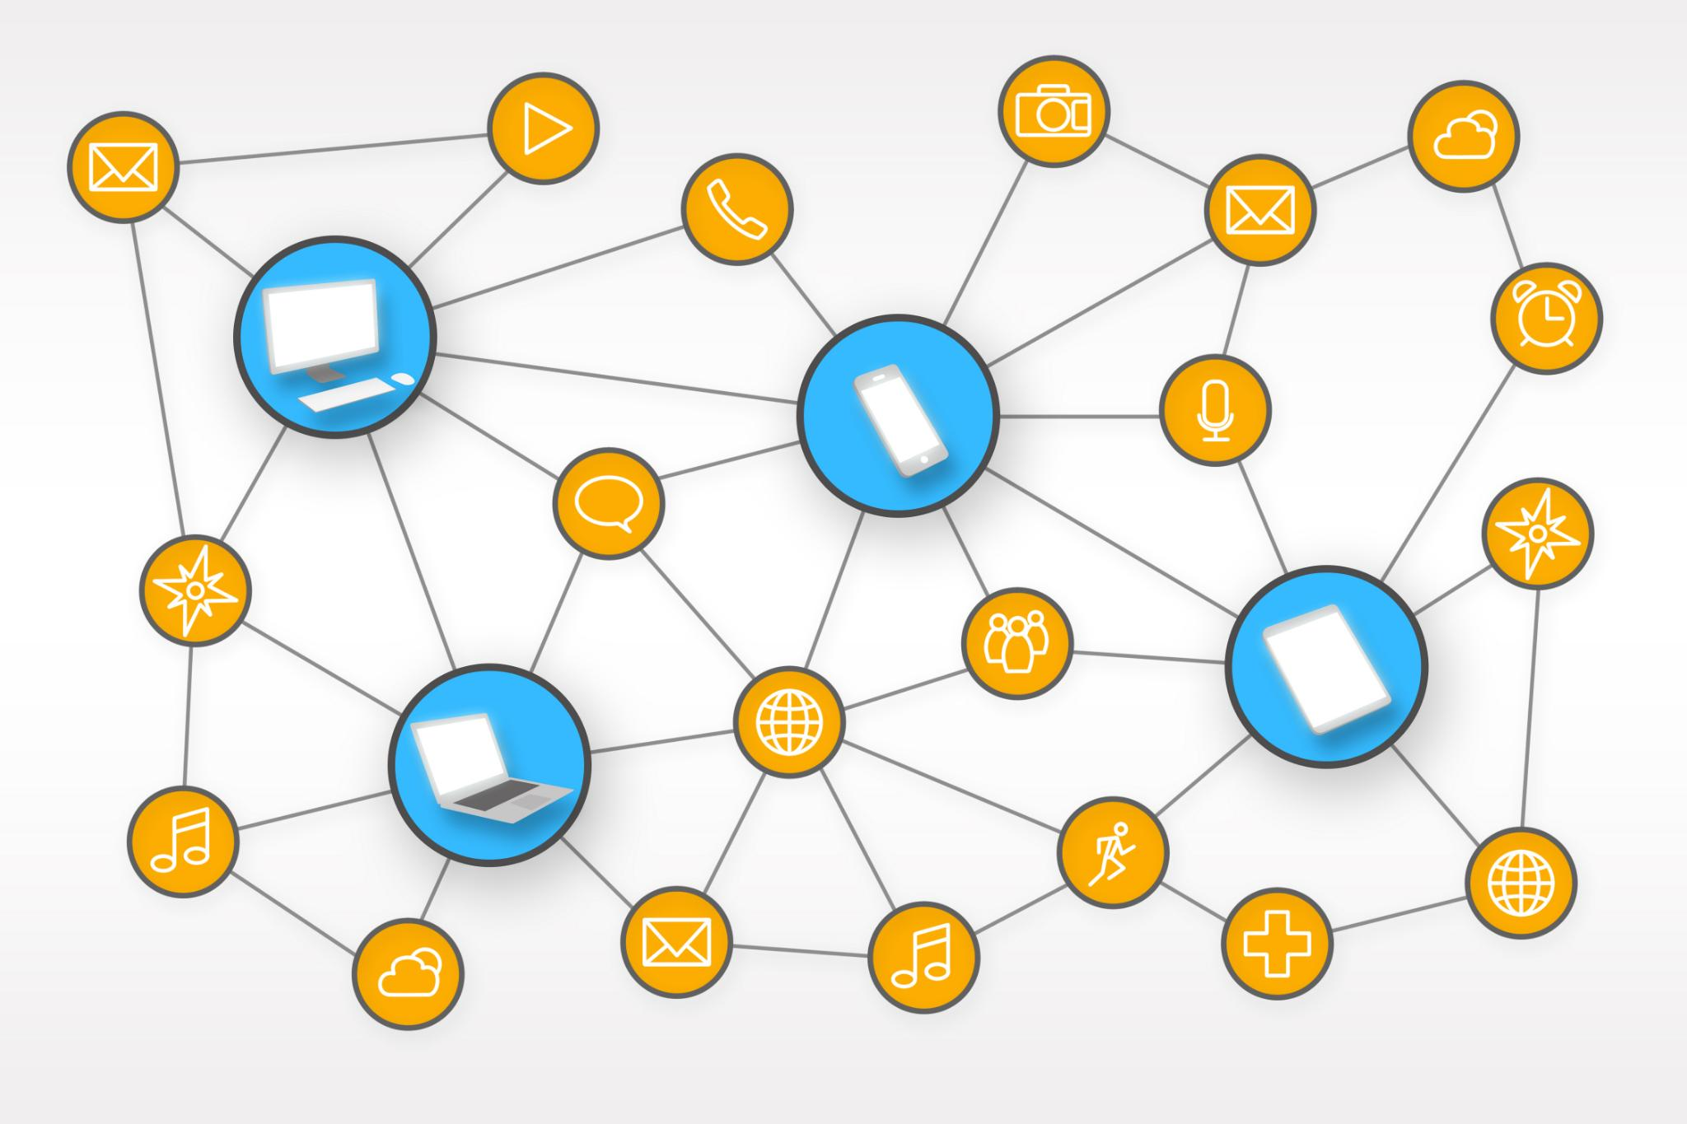
Leveraging Automation and Tooling for Incident Management
Automation in Alert Triage
Automation tools handle alert triage to minimize manual effort and speed up incident response times.
Streamlined Incident Escalation
Automated escalation processes ensure timely involvement of the right teams during incidents.
Integrated Monitoring and Communication
Combining monitoring and communication platforms reduces noise and enhances operational efficiency.

Slide 7

Continuous Improvement: Feedback Loops and Retrospectives
Identifying Pain Points
Feedback sessions reveal challenges and bottlenecks in the rotation process for targeted improvements.
Refining Schedules
Retrospectives enable adjustment of schedules to improve workflow efficiency and team balance.
Enhancing Performance
Implementing improvements based on feedback boosts team performance and satisfaction.

Slide 8

Case Studies and Industry Examples
Real-World Examples
Analyzing case studies from top organizations reveals practical pager rotation strategies and management solutions.
Lessons Learned
Successful approaches highlight lessons learned improving efficiency and responsiveness in on-call management.
Innovative Approaches
Innovative methods in pager rotation demonstrate adaptability and technological integration for modern workflows.

Slide 9
Conclusion
Importance of Pager Rotation
Optimizing pager rotation is vital to maintain system reliability and reduce downtime.
Leveraging Automation
Using automation tools improves efficiency and reduces human error in on-call management.
Continuous Improvement Culture
Fostering continuous improvement helps DevOps teams adapt and optimize incident responses.

Slide 10
References
Alicegoldfuss. (2019). Oncall-Handbook/optimizing_rotations.MD at master · Alicegoldfuss/Oncall-Handbook. GitHub. https://github.com/alicegoldfuss/oncall-handbook/blob/master/optimizing_rotations.md
PagerDuty, Inc. (n.d.). Implementation suggestions. PagerDuty Best Practices for On Call Teams Ops Guide. https://goingoncall.pagerduty.com/implementation/
PagerDuty. (2025, September 4). On-call rotations and schedules. https://www.pagerduty.com/resources/incident-management-response/learn/call-rotations-schedules/
(no attribution required for Microsoft 365 stock image gallery images)

